Slide 1
Data (for AI) for Climate Action
Dr. Mirko Kämpf | ecolytiq GmbH | 01.03.2023

Slide 2
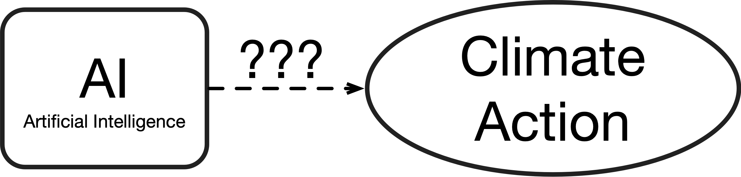
Notes:
We want to understand better, how AI can help us with effective climate action.
One example of Climate Action is reduction of Scope 3 emissions.

Slide 3
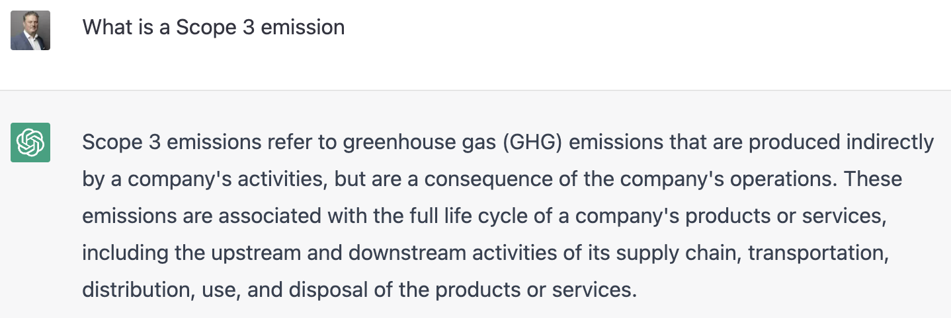
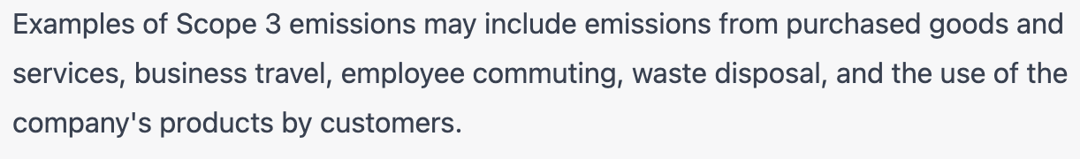
Notes:
Let’s use an AI system to find our what Scope 3 emissions are:
- Greenhouse gas emissions related to the products and services a company offers. - end 2 end.

Slide 4
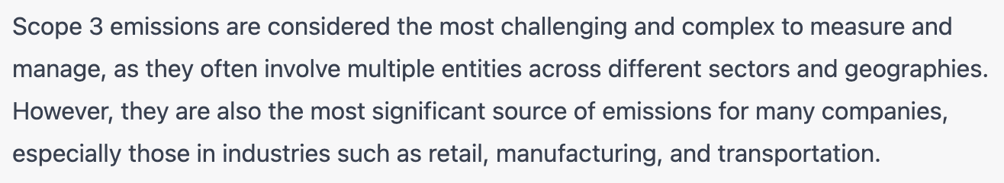
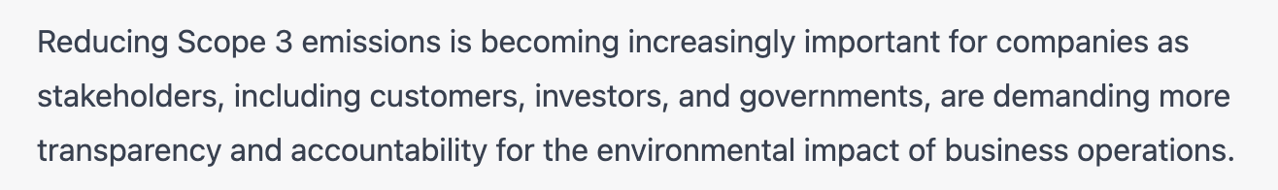
One Option to take Climate Action: Reduce Scope 3 Emissions

Slide 5
Reducing Scope 3 emissions is becoming increasingly important!

Slide 6
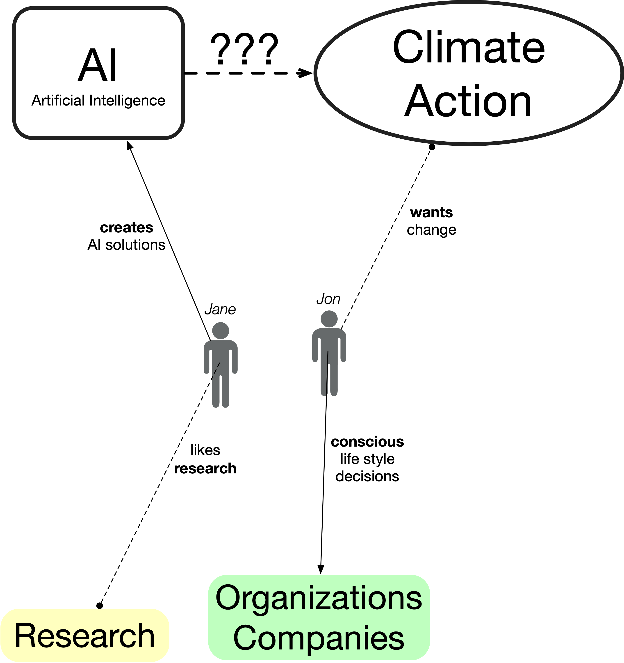

Slide 7
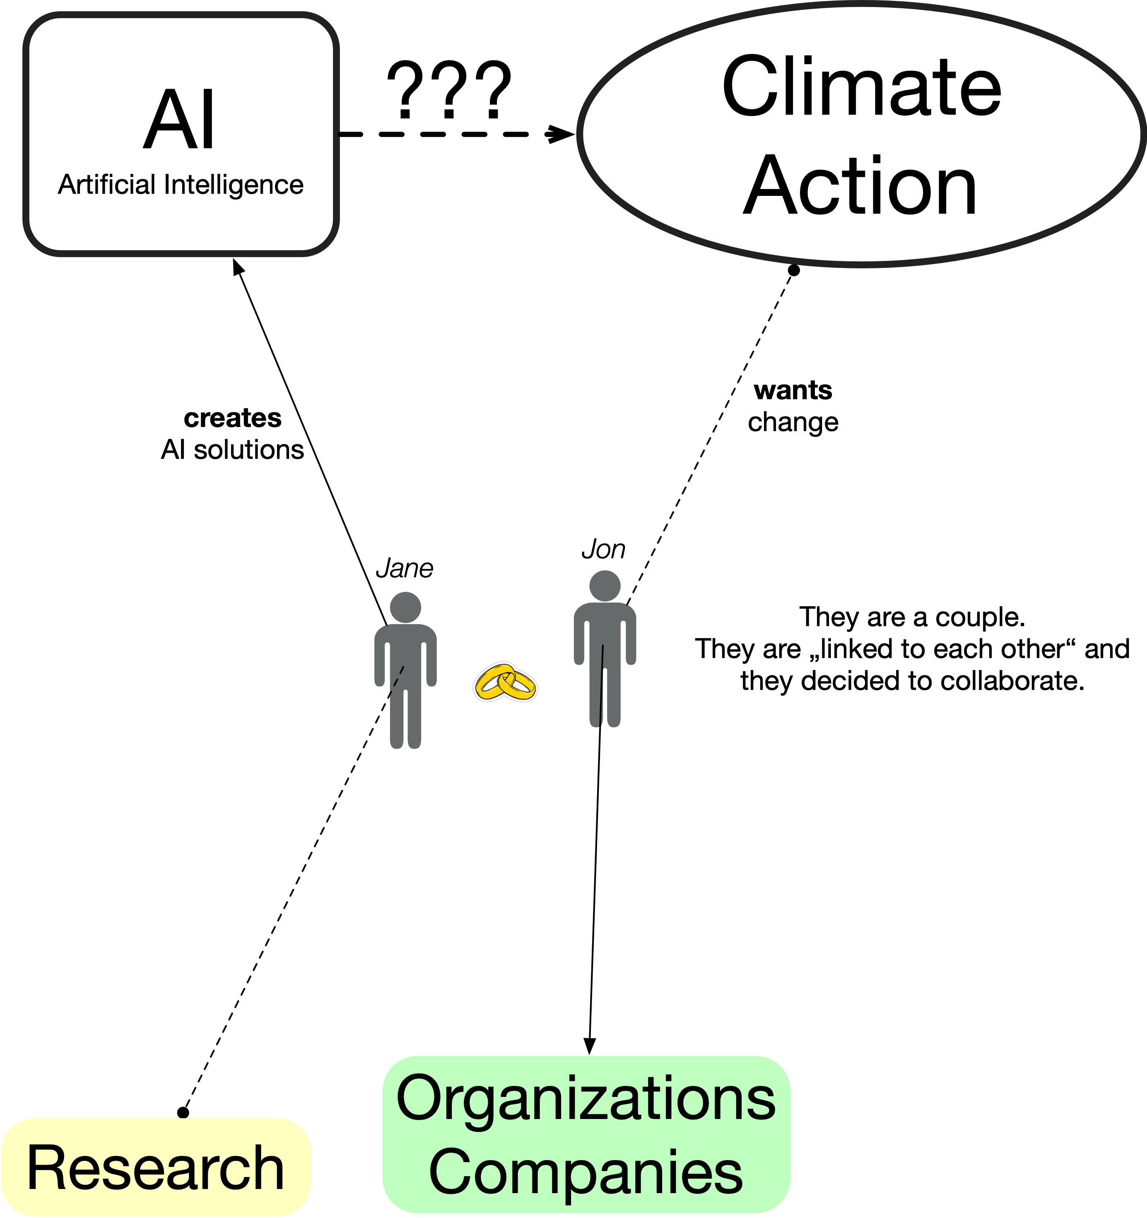

Slide 8
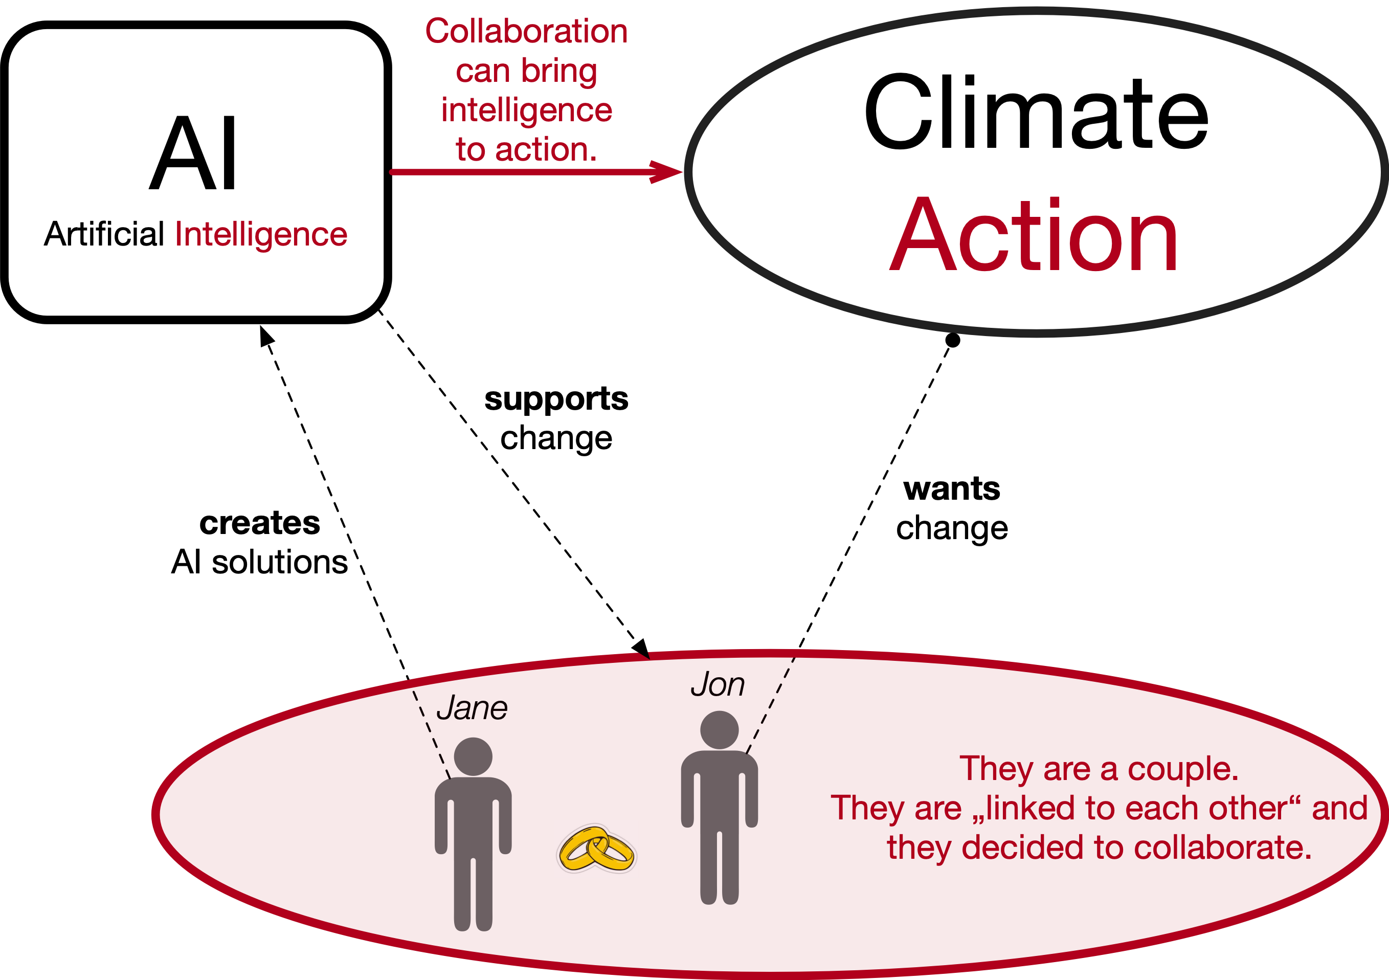
Notes:
This is a simple example. Mathematicians would say: a trivial solution. But reality requires a different solution.

Slide 9
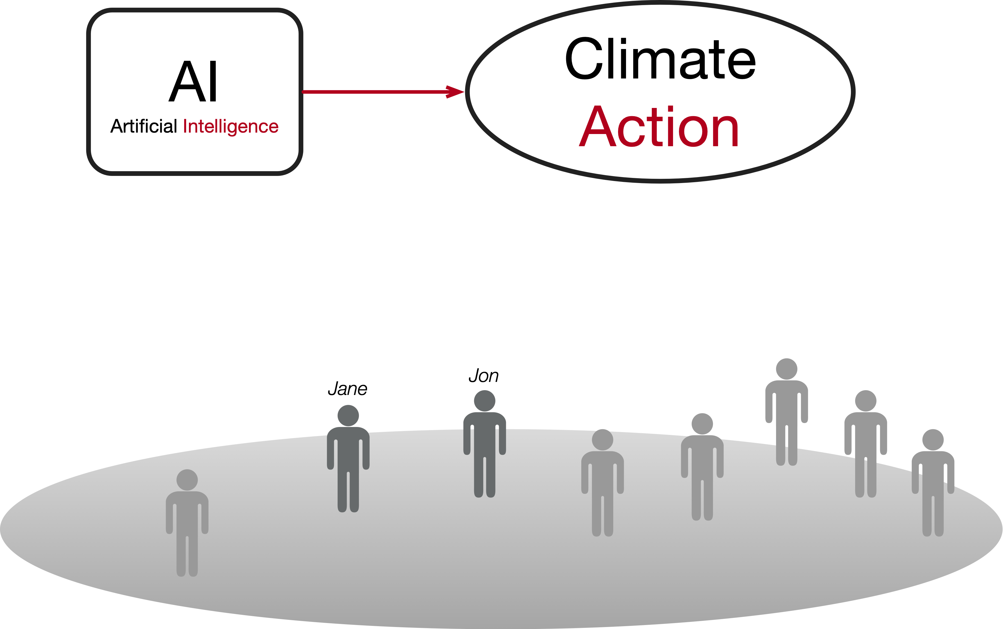
Notes:
In reality, there are many people.

Slide 10
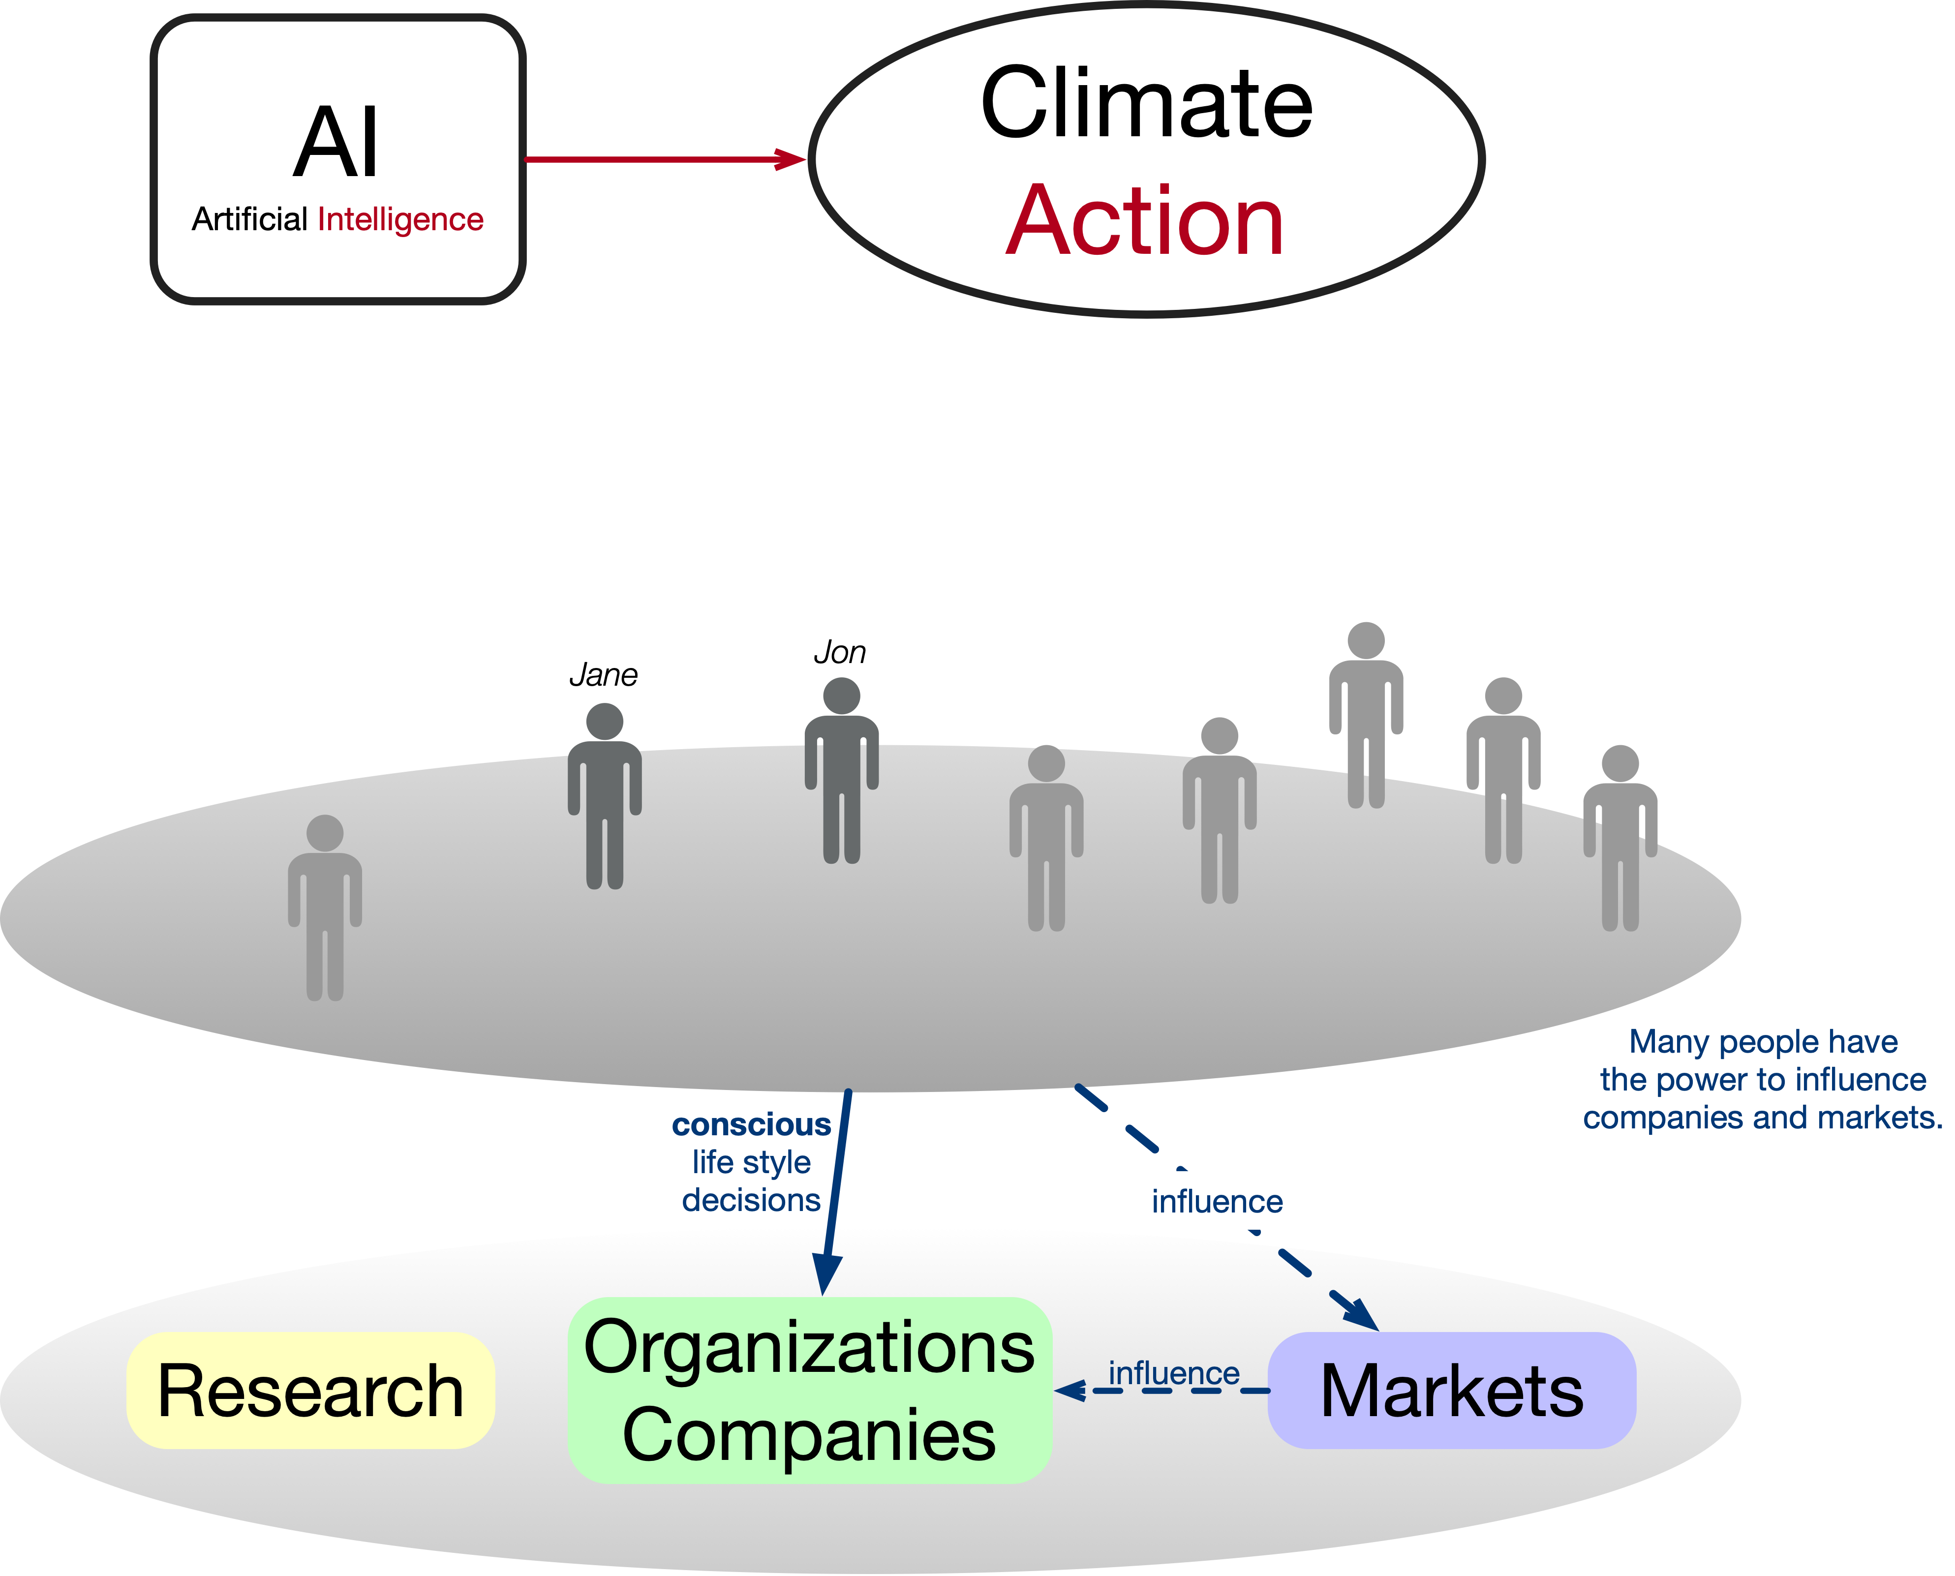
Notes:
… and many organization. They interact in markets and influence each other.
Since many people can have the power to influence a market, we can assume that they want to collaborate.

Slide 11
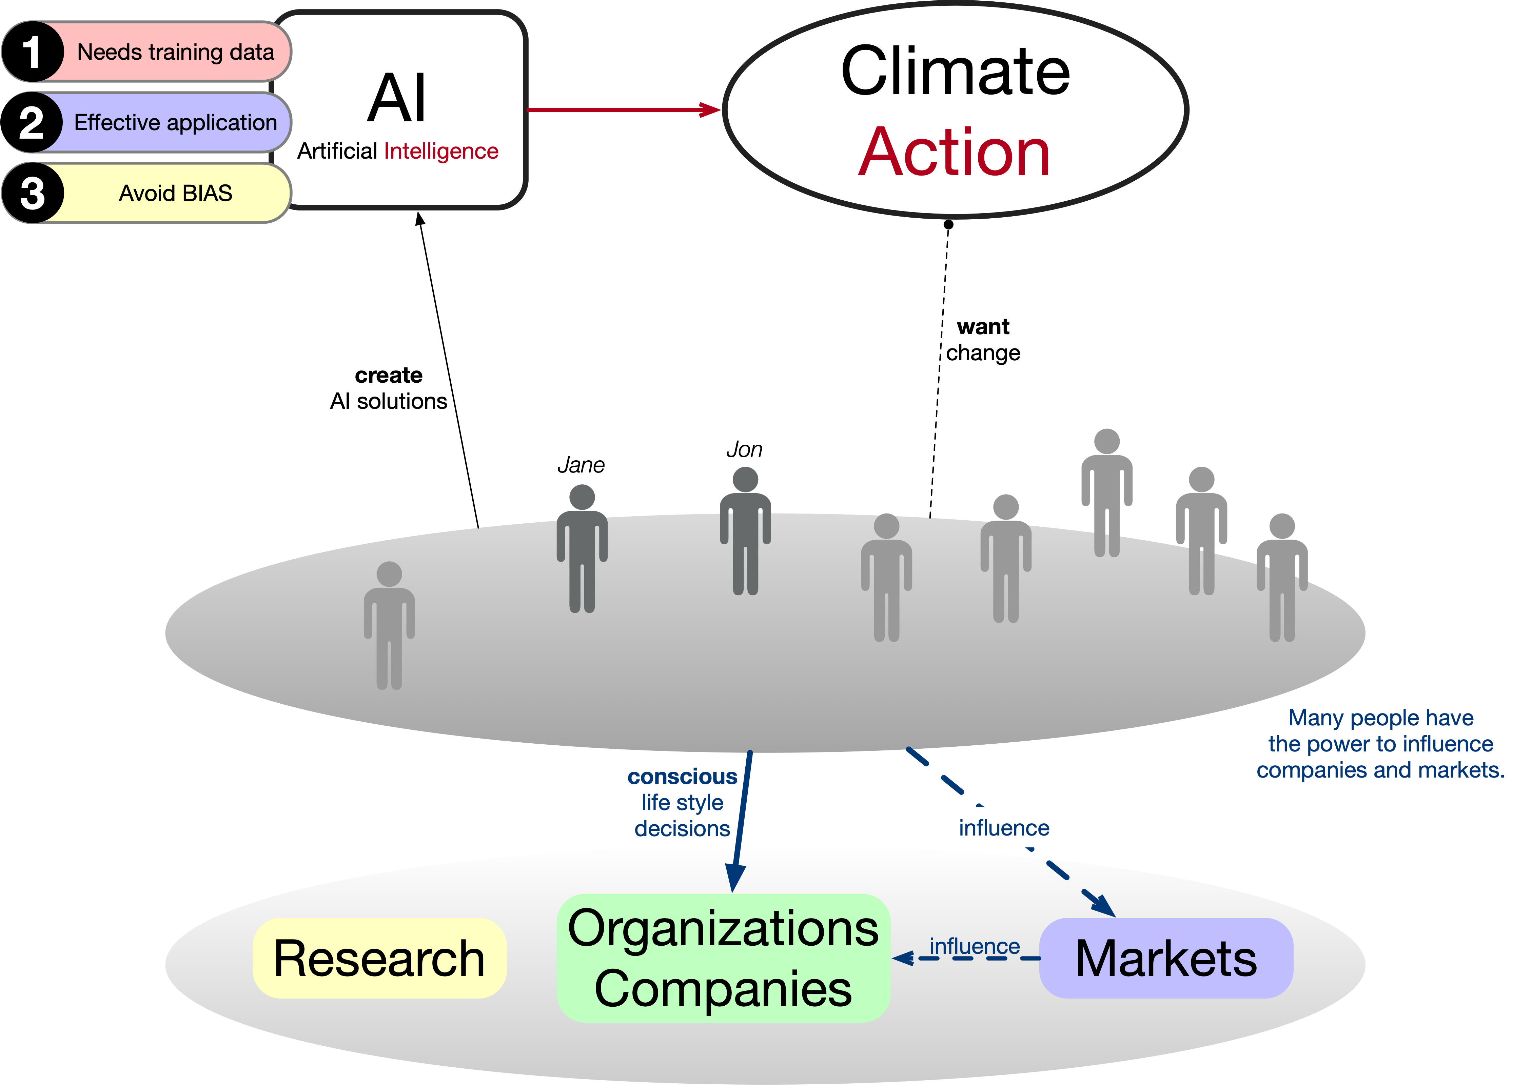
Notes:
They decide to work on AI solutions.

Slide 12

Notes:
Because of the complexity it is not a single person any longer, but rather research groups, companies and organization drive the development around AI. This alone does not lead to Climate Action. AI Systems can only support humans.

Slide 13
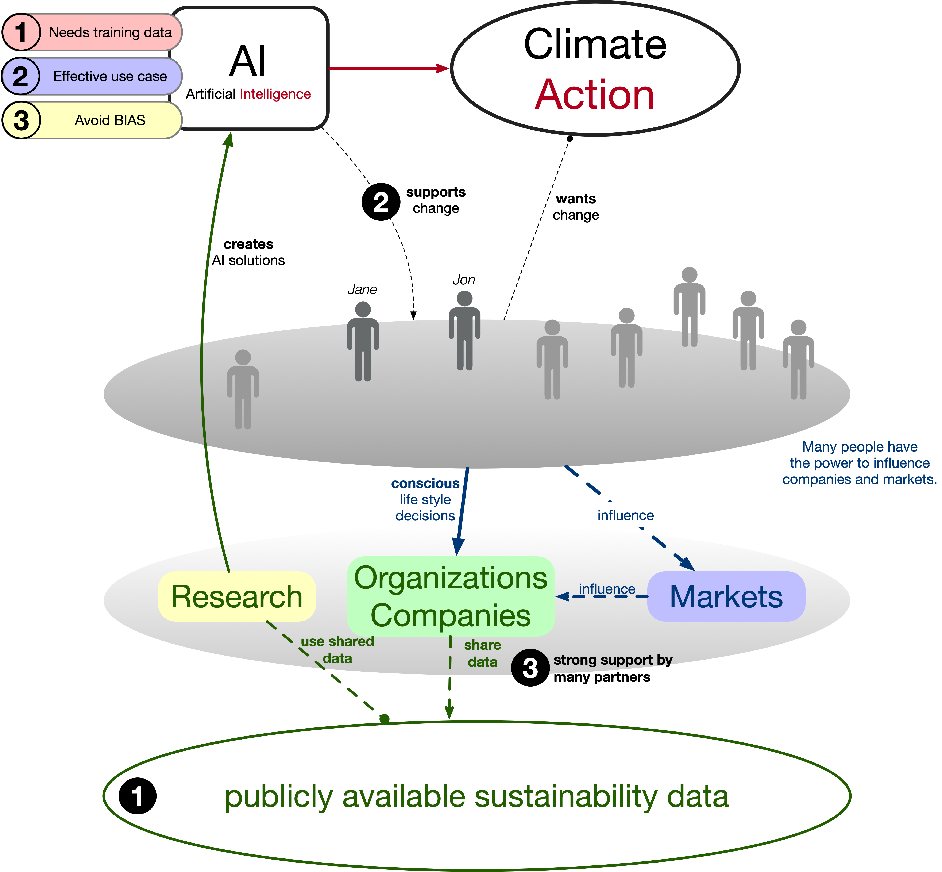
Notes:
But directly linked to AI there are three problems:
1-We need a lot of good training data.
2-We need effective applications and use cases which drive Climate Action.
3-And we must avoid bias during model training.
All these problems can’t be solved by Jane and Jon alone.
Solutions are highlighted in the sketch.

Slide 14
(1) - The Internet of Sustainability
(2) - Collaborative Usage of Impact data
(3) - Federated Learning on distributed data
Notes:
Next, I want to explain those three aspects a bit more. All 3 are linked to the idea of using AI to make our world a better place.
But before AI can be effectively used, some very important fundamental work must be done.
Data must be accessible. We need the right data. Also, we need clear use cases. Such that help people to make better decisions.
Collecting data just for the sake of having data collected does not make any sense.
But we can rethink, how existing data might can be used in a collaborative mode.
We do not have to give away our data to a centralized data processor. Federated Learning will open the doors for more AI use cases. And even better, with federated Learning we can reduce BIAS in AI model training.

Slide 15
(1) - The Internet of Sustainability
(2) - Collaborative Usage of Impact data
(3) - Federated Learning on distributed data
Notes:
I want to talk about three aspects of using technology and data. All 2 are linked to the idea of using AI to make our world a better place.
But before AI can be effectively used, some very important fundamental work must be done.
Data must be accessible. We need the right data. Also, we need clear use cases. Such that help people to make better decisions.
Collecting data just for the sake of having data collected does not make any sense.
But we can rethink, how existing data might can be used in a collaborative mode.
We do not have to give away our data to a centralized data processor. Federated Learning will open the doors for more AI use cases. And even better, with federated Learning we can reduce BIAS in AI model training.

Slide 16
Our Problem:
Lot’s of data is available on the internet.
But It is hard to find, to access, and to uses it!
Notes:
Because the internet is already available,
we should ask: What can we do with it to manage our sustainability data?
Sustainability data is not easy to find.
Data is not standardized.

Slide 17

What do we mean by
The Internet of Sustainability?
The Internet of Sustainability is a concept with the aim to publish supply chain-relevant sustainability data in a standardized and structured way. ​
It combines existing technologies and data sources to accelerate the transfer of knowledge needed for sustainable development.

Slide 18
A Solid Data Pod is a Software-as-a-Service solution that helps businesses to protect, administer and publish data.
Based on the Solid Data Pod technology the concept of Decentralized Standardized Sustainability Data Stores (DSSDS) is focused on sustainability data shared by companies.
Each sustainability report becomes an interconnected machine-readable data storage accessible to everyone.
The Internet of Sustainability as an ecosystem offers integrated impact-as-a-service solutions.
What is the
DNA
of the
Internet of Sustainability?

Slide 19
The Internet of Sustainability is based on several storage layers of data processing, structuring and provision:
Product-relevant Data Layer: these information contain supply chain-relevant data on product level, like the digital product passport
Expert Layer: additional data from professional services, like carbon accounting companies
Structured Data Layer: data structured in standardized processes
Raw Data Layer: published from companies, organisations or individuals in various formats
Layered structure of the Internet of Sustainability
Technological infrastructure
(META, PODs, API)

Slide 20
Structure of the Internet of Sustainability
Carbon Accounting Provider
IoS Impact Report Publisher
IoS Impact Information Provider
HTML page with data entities in microformats
/sustainability.txt File with report data or report URL
PDF
XML
RDF
Merchant
ecolytiq
Consumer
Product relevant data
Unique
Product identifier
Digital
Product Passport
Open Banking Provider
Data generation & verification
Data standardization & compatibility
Data provision
Notes:
Das IoS ermöglicht ein praxisnahes DPP Scheme , das im ersten Schritt auf standardisierten automatisierten Auswertungen von Nachhaltigkeitsberichten beruht.
Im weiteren ist der standardisierte Zugang zu weiteren Datenquellen angedacht.
Der Ansatz ermöglicht strukturiert Zugang zu produktrelevanten Daten aus Nachhaltigkeitsberichten.
Die automatisierten Prozesse sind per se interessensneutral und richten sich nicht nach vorbestimmten Ziel- oder Ergebnisvorstellungen der verschiedenen Stakeholder aus. Sie sind länder- und regionenübergreifend.
Datenquellen aber auch Datenlücken werden transparent gemacht.
Der Fokus liegt auf Skalierbarkeit des Systems und der Interoperabilität von Datenspeichern und –formaten.

Slide 21

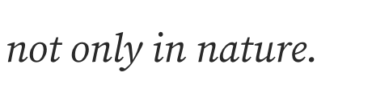
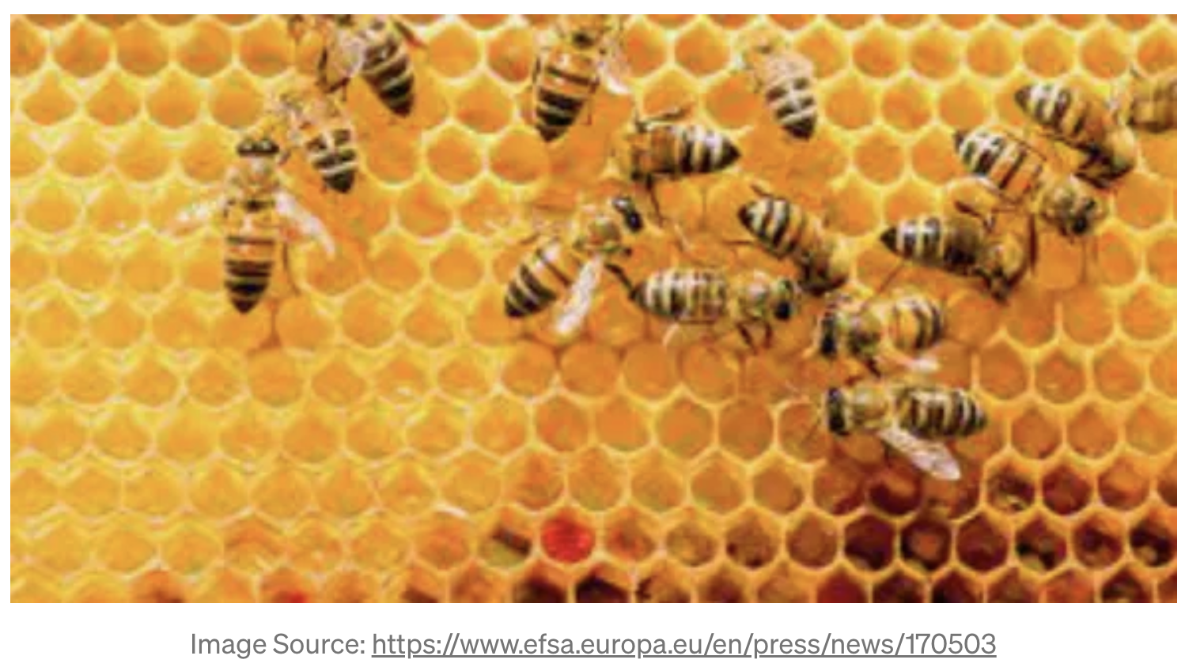

It is all about taking action!
As long as individuals or just a few organizations care about this topic, it won‘t fly.
https://medium.com/@semanpix/information-is-the-next-honey-thoughts-about-data-products-in-a-digital-society-a364f11aea94

Slide 22
(1) - The Internet of Sustainability
(2) - Collaborative Usage of Impact data
(3) - Federated Learning on distributed data
Notes:
I want to talk about three aspects of using technology and data. All 2 are linked to the idea of using AI to make our world a better place.
But before AI can be effectively used, some very important fundamental work must be done.
Data must be accessible. We need the right data. Also, we need clear use cases. Such that help people to make better decisions.
Collecting data just for the sake of having data collected does not make any sense.
But we can rethink, how existing data might can be used in a collaborative mode.
We do not have to give away our data to a centralized data processor. Federated Learning will open the doors for more AI use cases. And even better, with federated Learning we can reduce BIAS in AI model training.

Slide 23
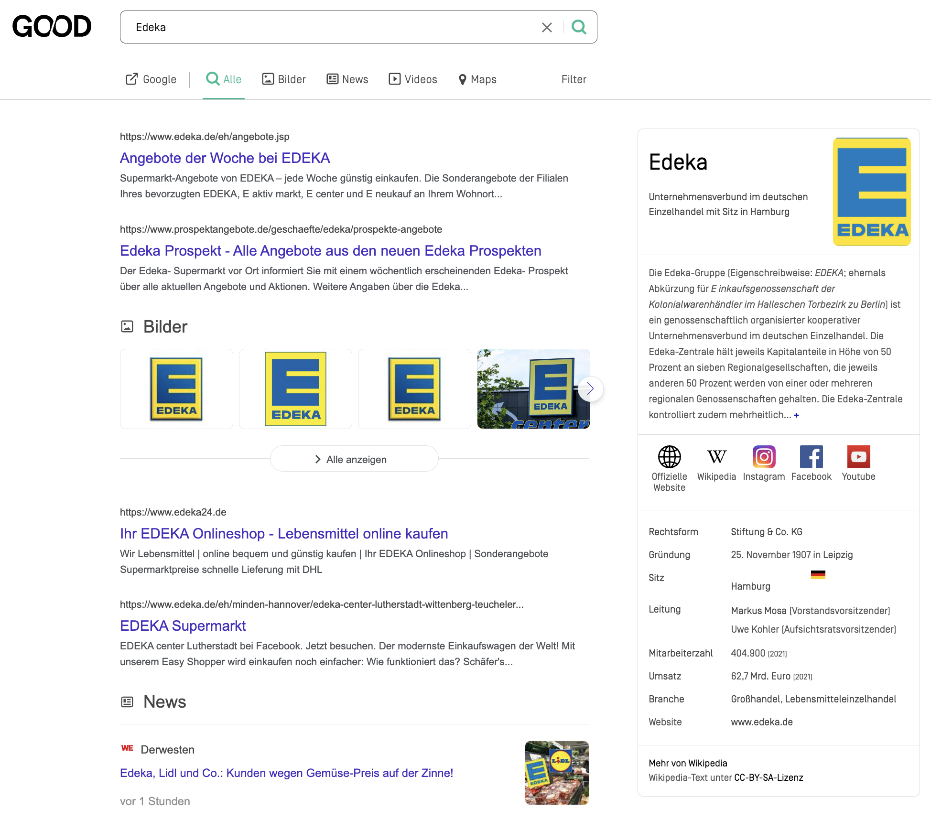
How easy it would be …
for me, to take action …. if I would know, if a business collaborates by publishing impact data.
Impact Report

Slide 24

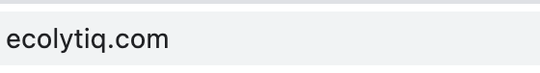
Traffic is secured - webpage owner cares about security !!!

Slide 25

Traffic is secured - webpage owner cares about security !!!
Impact data is available – business partner supports transparency !!!

Slide 26
I shared just 2 of our examples.
But it is all about you! Collaboration is a team sport!

Slide 27
(1) - The Internet of Sustainability
(2) - Collaborative Usage of Impact data
(3) - Federated Learning on distributed data
Notes:
I want to talk about three aspects of using technology and data. All 2 are linked to the idea of using AI to make our world a better place.
But before AI can be effectively used, some very important fundamental work must be done.
Data must be accessible. We need the right data. Also, we need clear use cases. Such that help people to make better decisions.
Collecting data just for the sake of having data collected does not make any sense.
But we can rethink, how existing data might can be used in a collaborative mode.
We do not have to give away our data to a centralized data processor. Federated Learning will open the doors for more AI use cases. And even better, with federated Learning we can reduce BIAS in AI model training.

Slide 28
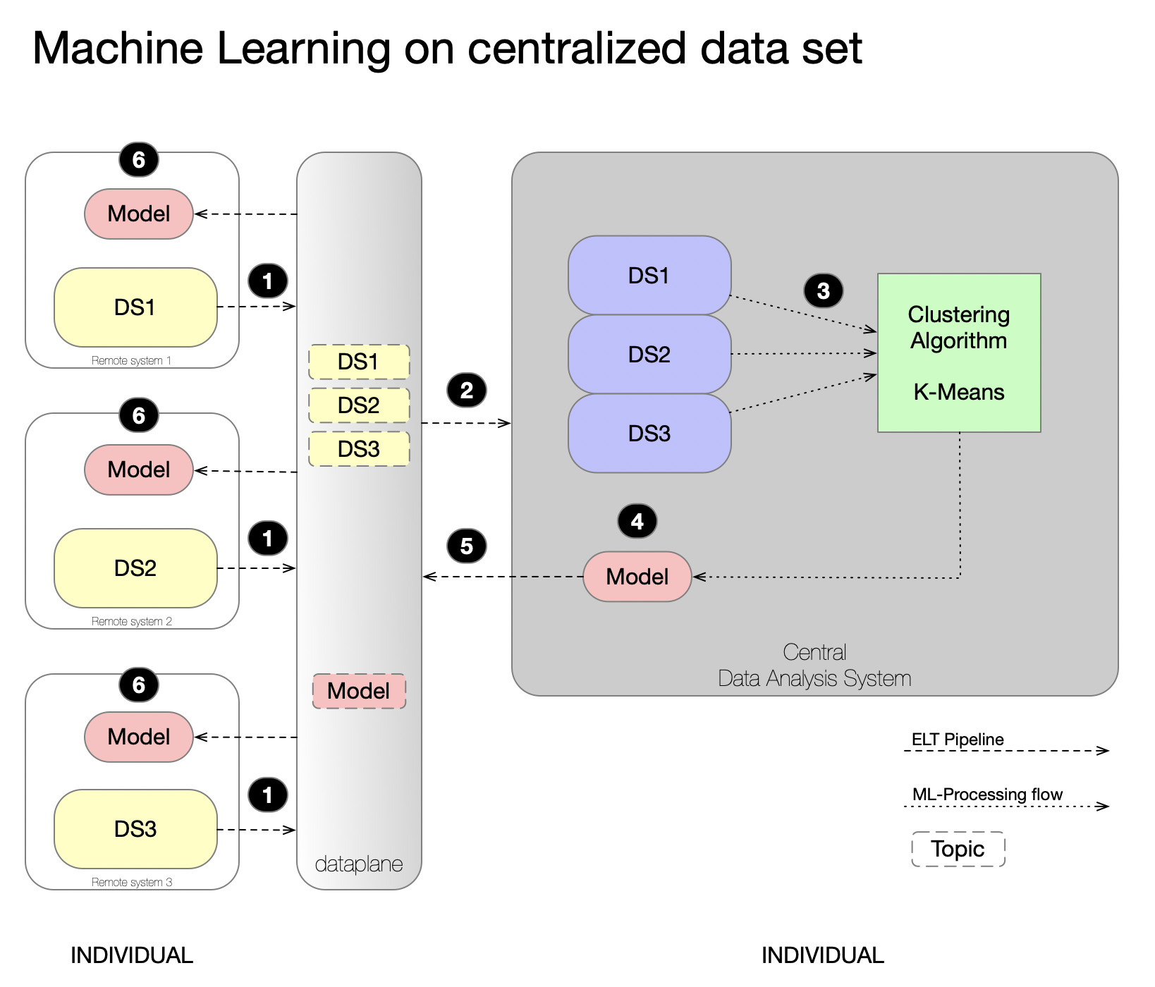

Slide 29
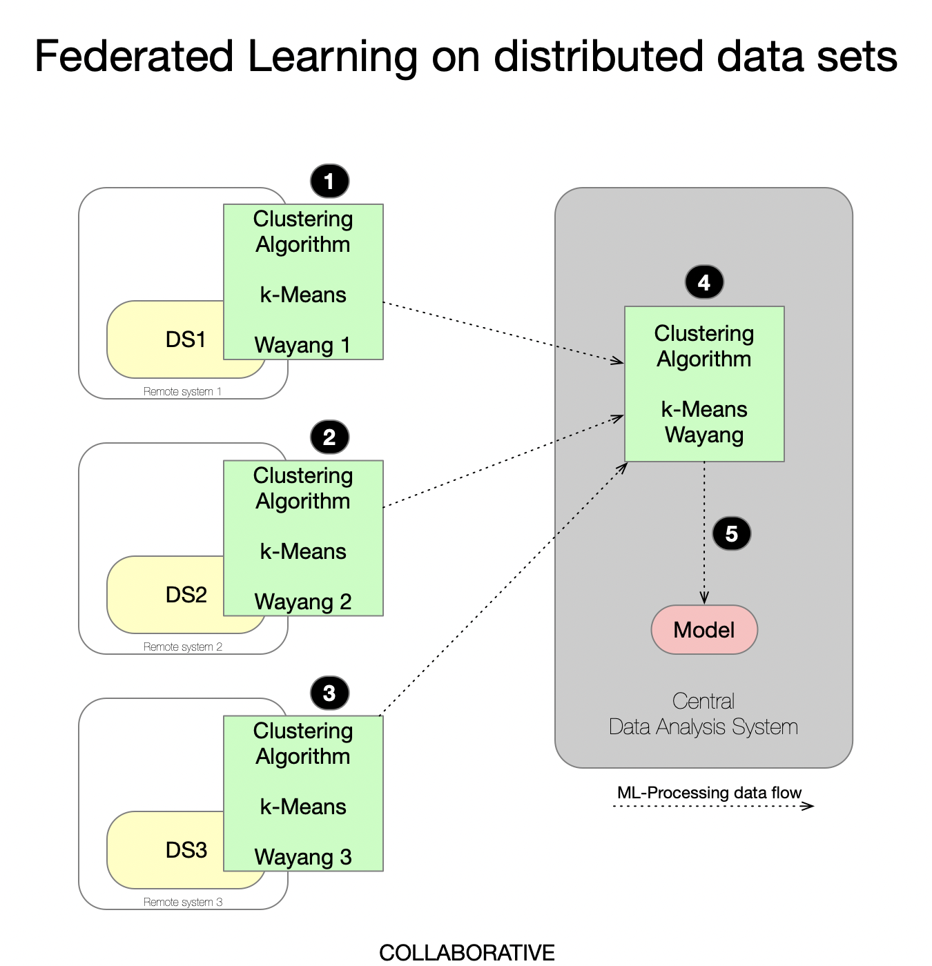

Slide 30
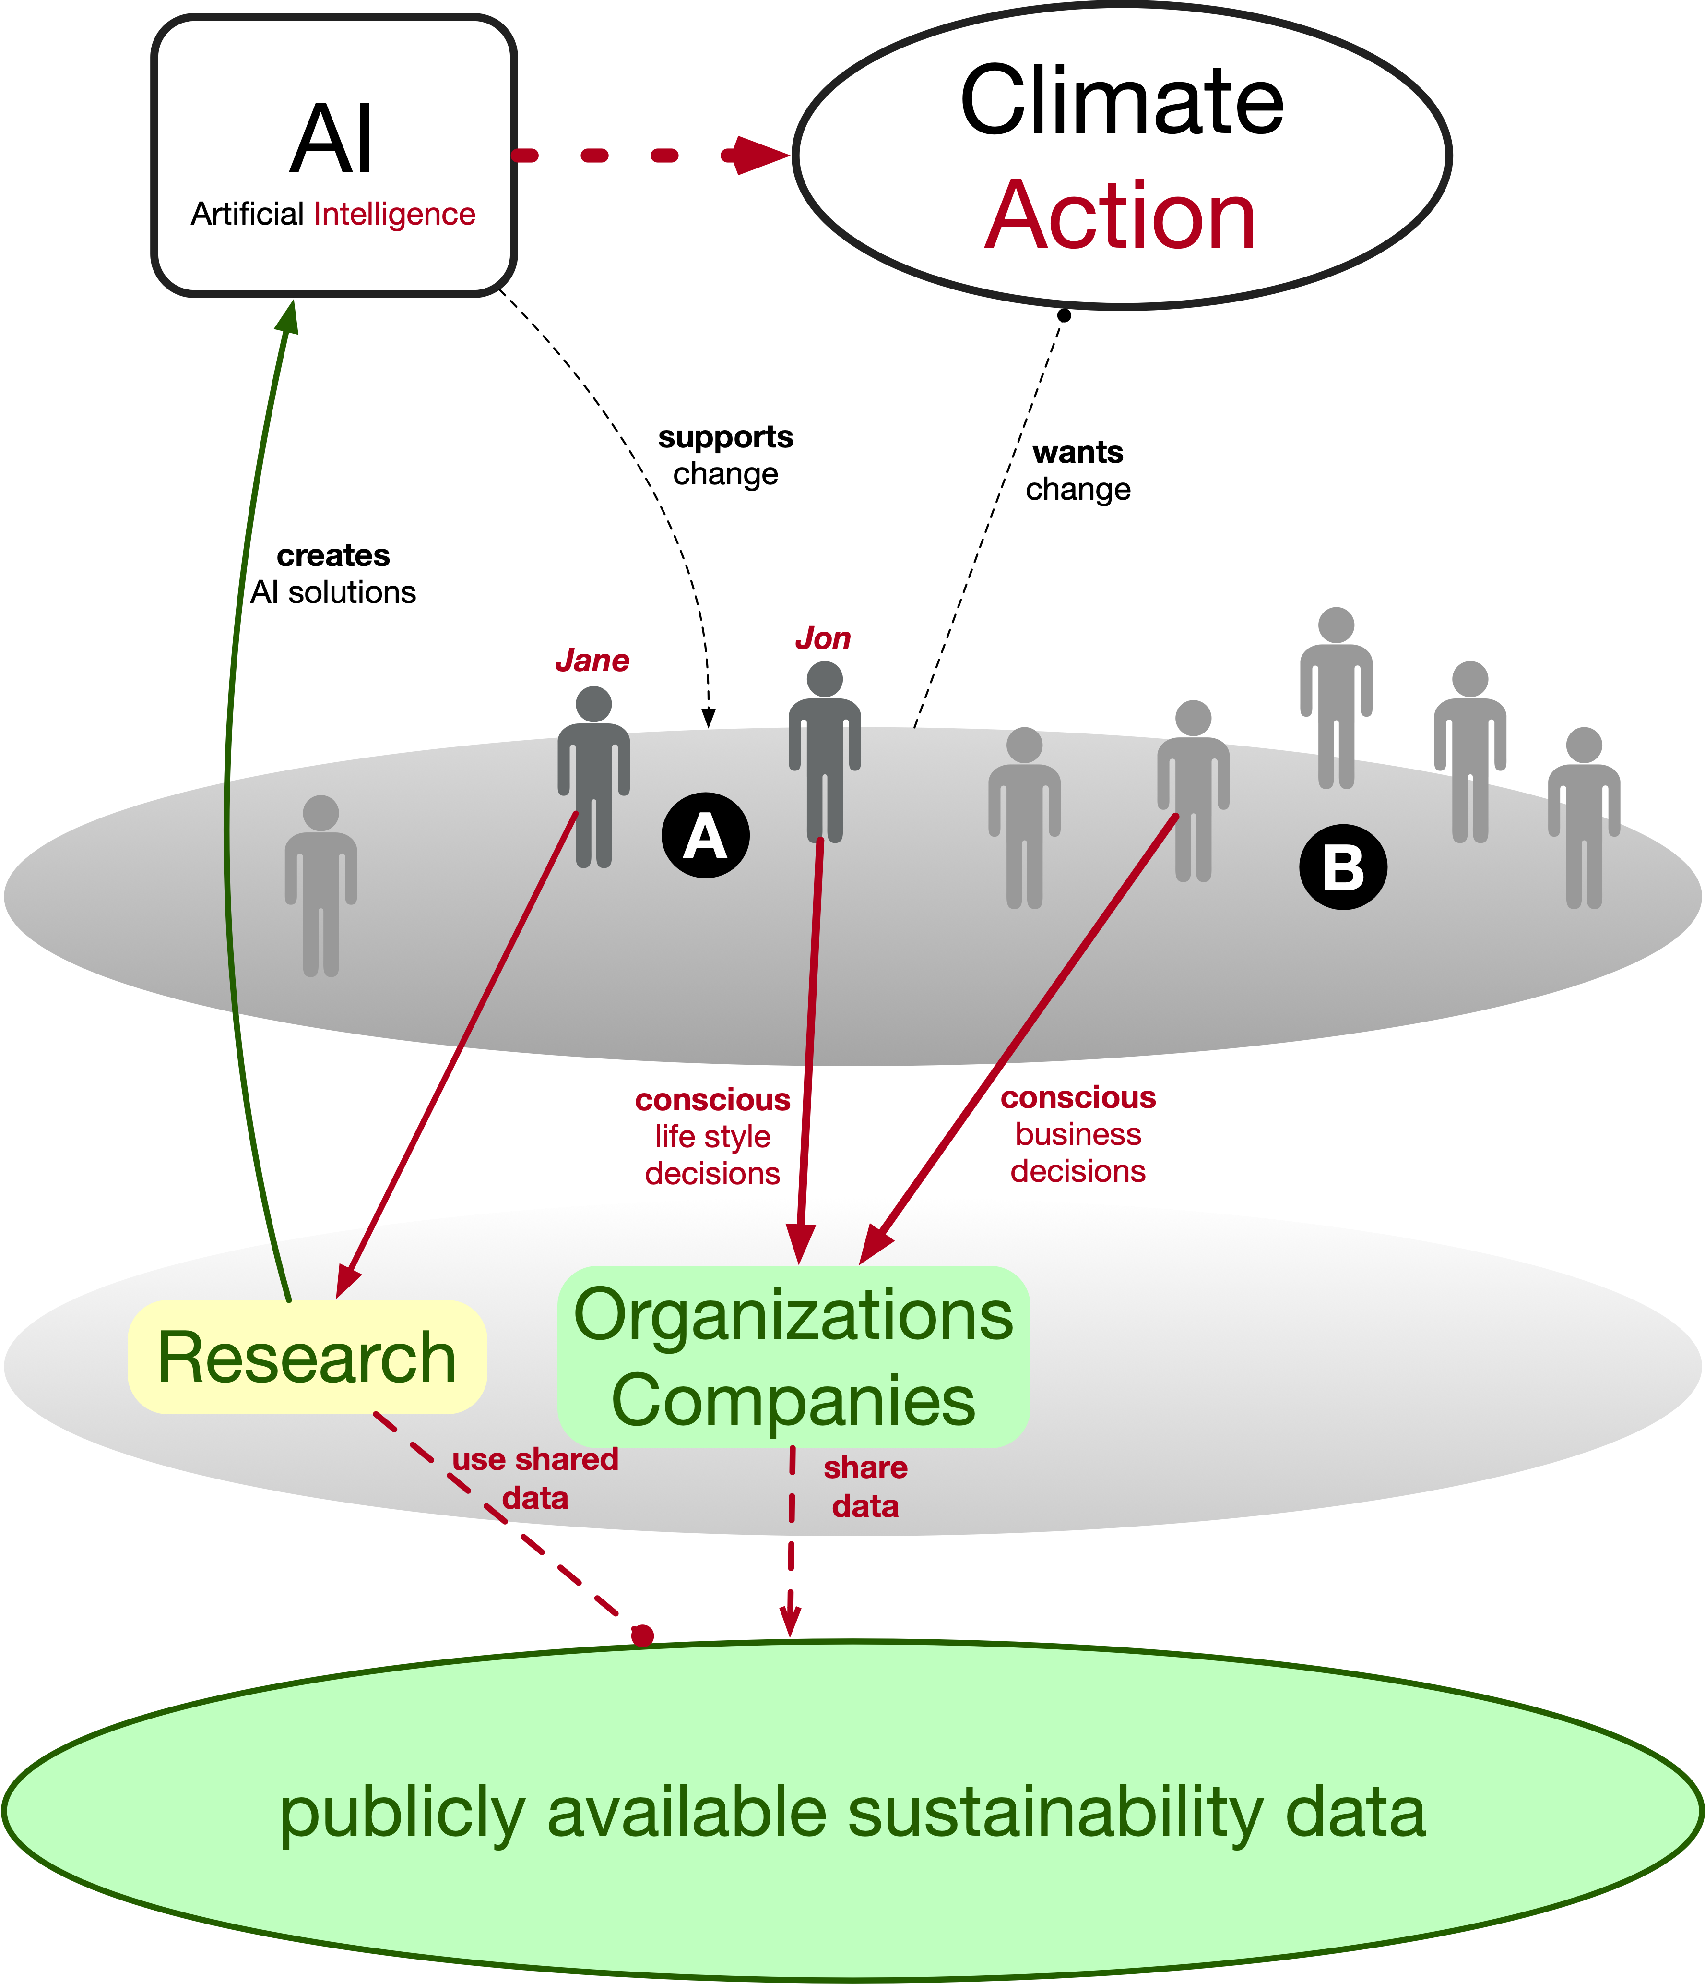

Slide 31
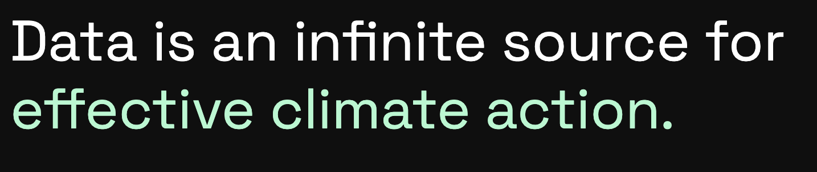
➔ Data sharing is climate caring !

